Slide 1
Revision 1

Slide 2

CALC FREE
Identify matrix dimensions, square, row, column, zero, identity and diagonal matrices.
An example is given in the 2 x 3 matrix below. 2 x 3 is the size or dimensions of the matrix which is always stated as rows x columns.
$$\left[\begin{matrix}3 & 4 & 0 \\ −1 & 3 & −2\end{matrix}\right]$$
Row 1
Column 2

Slide 3
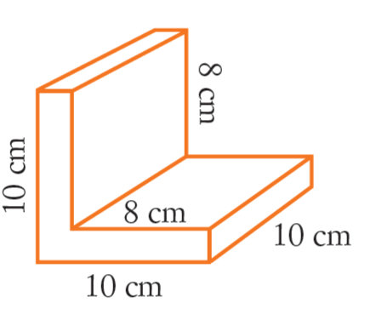
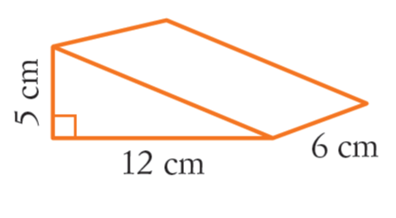




CALC FREE
Calculate area, surface area and volume without a calculator.
13 cm
C-S: 10 x 10 – 8 x 8 = 36
C-S: 0.5 x 12 x 5 = 30
SA : 2(36) + 2(10 x 10) + 2(8 x 10) + 2(2 x 10)
SA : 2(30) + 6(5) + 6(12) + 6(13) =
SA : 72 + 200 + 160 + 40 = 472${cm}^{2}$
SA : 60 + 30 + 72 + 78 = 240${cm}^{2}$
V : 36 x 10 = 360${cm}^{3}$
V : 30 x 6 = 180${cm}^{3}$

Slide 4
CALC FREE
Calculate simple interest without a calculator.
Kelsey invested $10 000 at a rate of 5% p.a. simple interest over 6 years.
How much interest did she gain? What was the total value of her investment?
10 000 x 5% x 6
= 500 x 6
= $3000
10 000 + 3000
= $13 000
She earned $3000 interest.
The total value of her investment was $13 000.

Slide 5
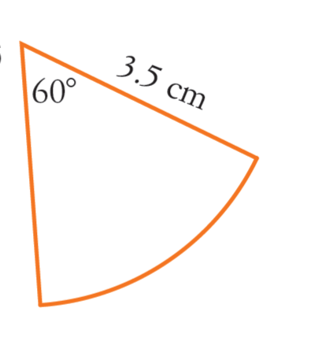

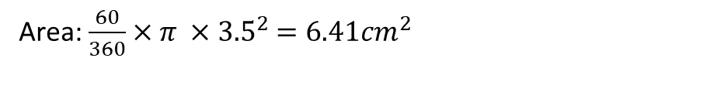
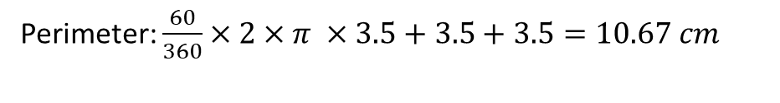
CALC ASSUMED
Calculate perimeter and area of sectors of circles.
Curved line: $\frac{60}{360}×2×π ×3.5$
Straight edges: 3.5 + 3.5
Perimeter: $\frac{60}{360}×2×π ×3.5+3.5+3.5=10.67 cm$
Area: $\frac{60}{360}×π {×3.5}^{2} =6.41{cm}^{2}$

Slide 6
CALC ASSUMED
Calculate the total value of a portfolio and the total dividend the investor will receive.
Company | Number of shares | Value per share ($) | Dividend per share ($)
ABC Limited | 4000 | 0.86 | 0.05
DEF Group | 550 | 23.50 | 6%
GH Resources | 2500 | 3.40 | 0.28
IJ Technology | 8000 | 0.54 | No dividend
Total value of portfolio:
ABC: 4000 x 0.86 = 3440
DEF: 550 x 23.50 = 12925
GH: 2500 x 3.40 = 1350
IJ: 8000 x 0.54 = 4320
Total: = $22 035
Total dividend:
ABC: 4000 x 0.05 = 200
DEF: 550 x 0.06 x 23.5 = 777.50
GH: 2500 x 0.28 = 700
IJ: 8000 x 0 = 0
Total: = $1677.50

Slide 7
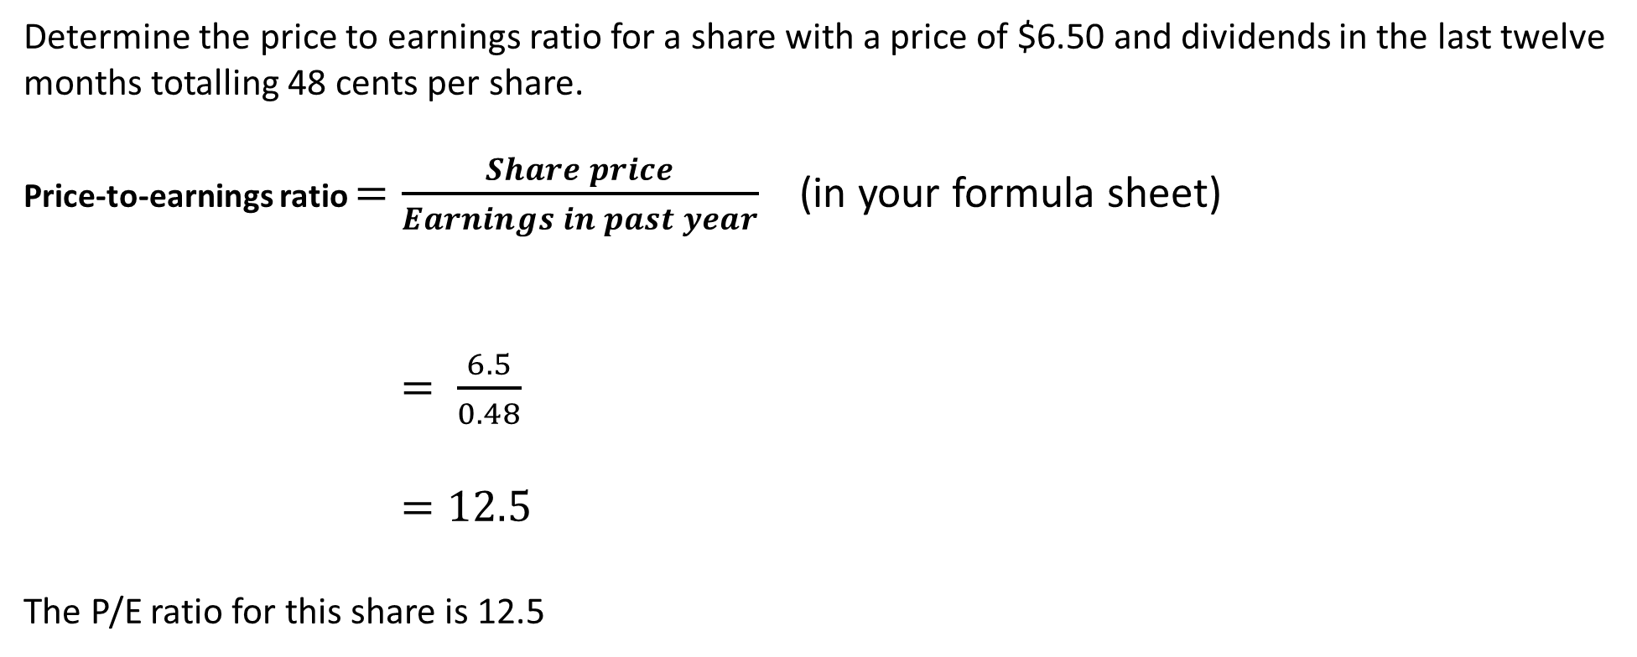
CALC ASSUMED
Determine the price to earnings ratio for a share with a price of $6.50 and dividends in the last twelve months totalling 48 cents per share.
Price-to-earnings ratio $=\frac{Share price}{Earnings in past year}$ (in your formula sheet)
$= \frac{6.5}{0.48}$
$=12.5$
The P/E ratio for this share is 12.5

